Slide 1
NJCEP Proposed Fiscal Year 2025 Electric Vehicle Budget and Program Plans – Stakeholder Meeting
June 4, 2024 1:30 pm – 3:30 pm

Slide 2
Agenda
Welcome and Introduction
Meeting Logistics
Process and Schedule for Comments
Overview of Budget
Public Comments

Slide 3
Meeting Logistics
Meeting will be recorded. All comments are public.
Registered speakers first.
Use “raise hand” function to request to provide oral comments
Speakers will be unmuted to provide comment; should state name and organization.
Meeting recording, PowerPoint, and comments will be available on the website.

Slide 4
Process and Schedule for Comments
Commenters are encouraged to file their comments directly to the specific dockets, Docket No. QO24040224 and QO24040223, using the “Post Comments” button on the Board’s Public Document Search tool.
Comments may also be submitted electronically to Board.Secretary@bpu.nj.gov in PDF or Word format with the subject “FY25 CRA, Budgets and Program Plans.”
Please note that these comments are considered “public documents” for purposes of the State’s Open Public Records Act. Commenters may identify information that they seek to keep confidential by submitting them in accordance with the confidentiality procedures set forth in N.J.A.C. 14:1-12.3.
Any questions may be submitted via email to Board.Secretary@bpu.nj.gov, with the same subject heading as above.
Comments will be accepted through Wednesday, June 12, 2024 at 5pm.

Slide 5
Overview of Budget
FY25 EV Budget Proposal (In $)
FY25 Program/ Budget Line | FY25 Budget
Electric Vehicle Program | 162,258,925
Plug In EV Incentive Fund | 32,583,925
CUNJ Administrative Fund | 5,500,000
CUNJ Residential Charger Incentive | 4,000,000
EV Studies, Pilots, and Administrative Support | 2,500,000
Clean Fleet | 28,900,000
Multi-Unit Dwellings (Chargers) | 32,875,000
EV Tourism | 10,900,000
E-Mobility Pilot Programs | 7,000,000
Electric School Buses | 30,000,000
School Bus V2G | 2,000,000
MHD Depot | 6,000,000

Slide 6
Proposed FY25 Programs
The Electric Vehicle (EV) Budget and Programs includes:
Charge Up Personal Vehicle Incentive
Charge Up Residential Charge Incentive
Clean Fleet Incentive Program
Multi-Unit Dwelling Incentive Program
EV Tourism Program
E-Mobility Pilots
School Buses
MHD Depot
Administrative Funds

Slide 7
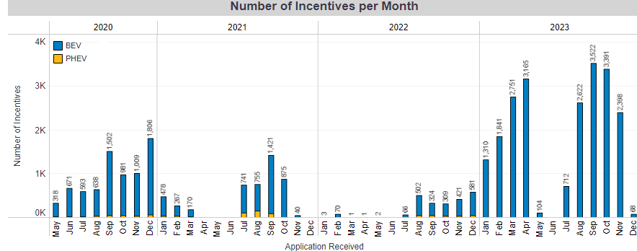
Charge Up Statistics
Chargeup.njcleanenergy.com
Notes:
Trying to drive people the statistics page of charge up website
JK updated 5/20.

Slide 8
Proposed FY25 Charge Up
Incentive Levels - New Program Design
EVs with MSRP < $55,000 will have a fixed incentive of $2,000.
Income qualified applicants, as identified in the Applicant Eligibility requirements, will be eligible for an additional incentive in the amount of $2,000.
Income Qualified Applicant Eligibility
To be eligible for the increased incentive for income eligible applicants, applicants must submit tax documentation to the Program Administrator verifying that in 2023 their Modified Adjusted Gross income (“MAGI”) met the following requirements:
Maximum MAGI of $75,000 for single tax filers;
Maximum MAGI of $112,500 for head of household tax filers; and
Maximum MAGI of $150,000 for joint tax filers.
Applicants who wish to claim the additional income-based incentive will be required to prequalify with the Program Administrator.
Orders, purchases and leases made before the official introduction of the low-income adder will not be eligible for the additional incentive.
Notes:
Will note we are working to provide an example of such notice
The MSRP cap will include all line items on the purchase or lease agreement which relate to the value of the vehicle itself (including but not limited to battery upgrades, autonomous upgrades, wheel and tire packages, audio, and infotainment system).
The MSRP cap will not include maintenance or vehicle care packages, additional vehicle accessories (i.e. first aid kits, floor mats, cargo nets, etc.), destination and delivery charges, tax, registration fees, title fees, and documentation fees since these line items do not relate to the value of the vehicle itself, but rather to the logistics, care, and maintenance of the vehicle.

Slide 9
The Income- Eligibility based incentive will open in the Fall 2024
Those purchasing an eligible vehicle prior to the opening of the income-eligibility based incentive will not be eligible to apply retro-actively

Slide 10
Proposed FY25 Charge Up
Eligibility
For vehicles that reserve funding at the time of order, the MSRP at the time of order must match the MSRP at time of purchase or lease.
If the Program Administrator announces that the Program will close due to expending all available funds, there will not be an opportunity to reserve funds for orders made outside the normal 14-day window.
If Dealerships or Showrooms do not intend to reserve funding at the time of order they must provide written notice to the customer that eligible vehicles will remain eligible for the incentive at the time of purchase or lease, pending availability of funds.
Dealerships and Showrooms that do not enter orders must provide updates to the Program Administrator regarding the number of pending orders.
Notes:
Will note we are working to provide an example of such notice
The MSRP cap will include all line items on the purchase or lease agreement which relate to the value of the vehicle itself (including but not limited to battery upgrades, autonomous upgrades, wheel and tire packages, audio, and infotainment system).
The MSRP cap will not include maintenance or vehicle care packages, additional vehicle accessories (i.e. first aid kits, floor mats, cargo nets, etc.), destination and delivery charges, tax, registration fees, title fees, and documentation fees since these line items do not relate to the value of the vehicle itself, but rather to the logistics, care, and maintenance of the vehicle.

Slide 11
Charge Up Statistics
Total funding for fiscal year
** Includes anticipated General Fund appropriation of $20 million

Slide 12
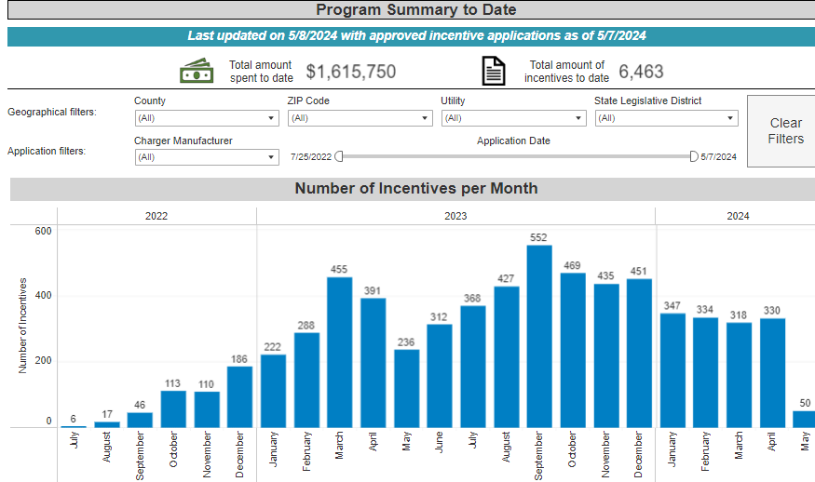
Proposed FY25 Charge Up
There are no proposed changes to the Residential Charger Program
Chargeup.njcleanenergy.com
Notes:
Trying to drive people the statistics page of charge up website
JK updated 5/22/24

Slide 13
Proposed FY25 EV Program Requirements
To provide consistency across our programs, BPU EV Program requirements include:
ENERGY STAR certified, as required by the Appliance Act (applicable for Level 1 & 2 chargers)
Vehicles and chargers may not be purchased prior to application
Meet or exceed federal uptime requirement – 97%
Networked dual-port charger that is on a network pre-approved by the State
Incentives may be stacked with utility make-ready incentives, up to the amounts allowed by the utility’s stipulation of settlement.
BPU incentives may not be stacked with the New Jersey Department of Environmental Protection’s (“NJDEP”) It Pay$ to Plug In Program for the same charger
Notes:
Changes to programs are in green

Slide 14
Proposed FY25 Clean Fleet
For state and local government entities including colleges, towns, schools and non-profits
Now administered by CSE
Incentive levels:
$4,000 for an EV
$5,000 L2 Public Charger
$4,000 L2 Fleet Charger + 50% (up to $5,000) for Make Ready
$50,000 Fast Charger (+50% (up to $50,000 for Make Ready for Fleet charger)
$10,000 for a Class 2b- 6 EV
50% bonus for Overburdened Municipalities
Notes:
Changes to programs are in green

Slide 15
Clean Fleet Statistics
Notes:
Will note that supply chain and procurement issues have slowed this program. But state starts accepting bids on chargers June 23rd

Slide 16
Proposed FY25 MUD
For MUDs with more than 5 units and dedicated off-street parking
Now administered by CSE
$4,000 per charger
Maximum award based on size of development
MUDs located in an Overburdened Municipality eligible for 50% bonus
Eligible applicants that are deed restricted, 100% affordable (low- and moderate-income) housing may also be eligible for a 50% bonus, Applicants may only receive one bonus
Notes:
Green is changes

Slide 17
MUD Statistics
Notes:
Will note supply chain issues impacted applications

Slide 18
Proposed FY25 EV Tourism
For tourism locations including downtowns, parks, hotels, historic sites
Incentive levels:
$5,000 for L2
$50,000 for Fast Chargers

Slide 19
EV Tourism Statistics
Notes:
Will note supply chain issues impacted applications

Slide 20
Proposed FY25 E-Mobility
This will fund future e-mobility programming as developed by Staff over the course of FY25, this could include:
Recommendations from “New Jersey Overburdened Communities Electric Vehicle Affordability Program Study”
E-bike and/or E-scooter incentives
E-ride share charging incentives
Other pilot programs associated with e-mobility options
Notes:
Tried to add in more “things” per GO conversation

Slide 21
Proposed FY25 School Bus Funding
This line represents:
$15 million legislatively required to be provided to DEP in FY24
An additional $15 million for a use to be determined
$2 million for potential V2G incentives in conjunction with the DEP School Bus Program
Notes:
Tried to add in more “things” per GO conversation

Slide 22
Proposed FY25 MHD Depot
This will fund the legislatively mandated MHD Depot Demonstration Program, work on designing the program will begin in FY25
Notes:
Tried to add in more “things” per GO conversation

Slide 23
PUBLIC COMMENTS

Slide 24
THANK YOU

